Slide 1
Visualising project relations on GitHub
Scala - Akka - D3.js

Slide 2
The problem
Relations between projects
Common commits form links
Programming languages form groups
Exploring the dataset
Interactive

Slide 3
Data metrics (1/3)
For the full data set:
#projects | 600K
#users | 400K
#commits | 14M
#unique project/user links per week | 3M
#project links | 13M

Slide 4
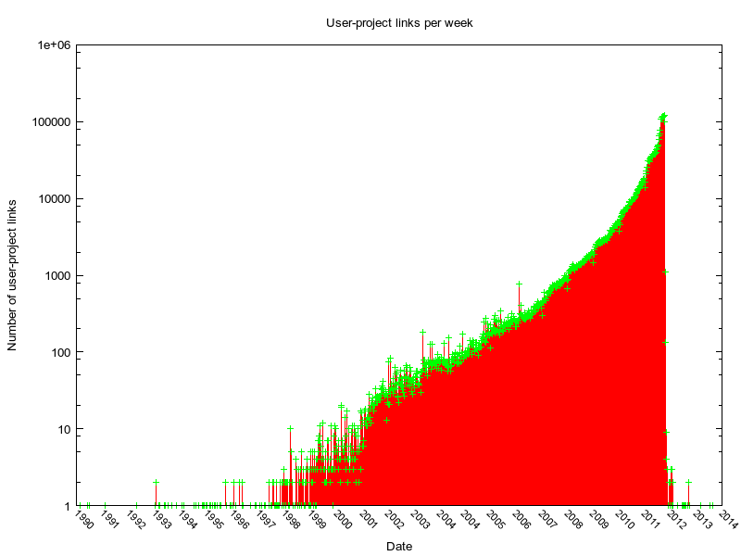
Data metrics (2/3)
User-project links per week

Slide 5
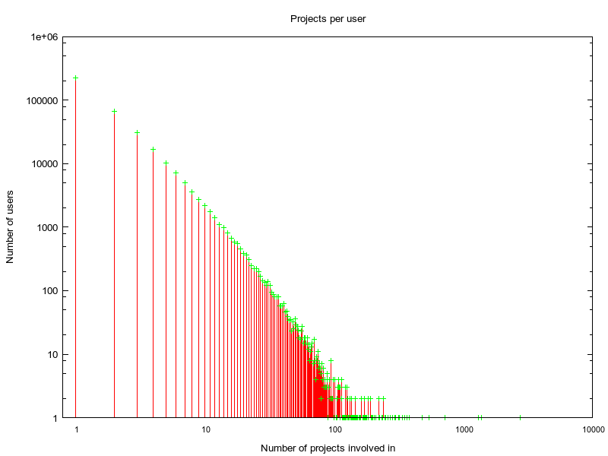
Data metrics (3/3)
User project involvement

Slide 6
Data processing (1/2)
Flow of map/filter/folds
Implement Sawzall aggregators (Lämmel, 2008)
MapReduce descendant
Aggregators for generic Scala collections
Idiomatic way of using
Mostly inferred
val commits : List[ Commit ] = ...
def projectsToPairs (ps: List[Project]):List[(Project,Project)] = ...
val linkMap =
commits . filter ( c => c. timestamp >= from && c. timestamp <= until )
.mapReduce [Map[User ,Set[ Project ]]]( c => (c.user ,c. project ) )
.values
.mapReduce [Map [( Project , Project ),Int ]]( projectsToParis )
.filter ( _._2 >= minWeight )

Slide 7
Data processing (2/2)
What can we do with the aggregators?
Set(1) |<| Set(2)// Set(1,2), monoid
Set(1) |<| 2// Set(1,2), element insert
1 |<| List(3,4)// 8, multiple elements insert
Map(1 -> 2) |<| (1 -> List(2,3))// Map(1 -> 7), 'multi-level'
words.mapReduce[String,Int] ( w => (w -> 1 ) )

Slide 8
Distributed processing
Computer2
Computer1
Reducer
Webservice

Slide 9
Visualisation
How to show the data properties?
Node size = #connected projects
Link width = #common committers
Node color = programming language
Graph updated incrementally, show evolution.
Language filtering in browser.

Slide 10
Preview

Slide 11
LOC
Aggregators + MapReduce (Scala) | 150 + 25
Shared processing code (Scala) | 150
Local processing (Scala) | 50
Akka processing (Scala) | 90
Visualisation (Javascript) | 700 ;)

